Slide 1



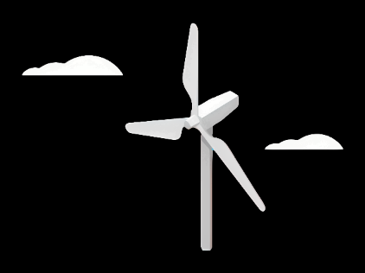
Weekly Report: Rotor Blade Design
Week number: 02
Date: 30.09.2025
Supervisor: Prof. Dr. rer. nat. Alois Schaffarczyk
Group Members: Jay Pandya, Kandarp Pathak, Harsh Panchal, Daniyal Sikandar

Slide 2
NREL 5 MW Reference Blade
> INTRODUCTION:
• Developed by NREL (National Renewable Energy Laboratory)as a reference offshore turbine
• Rated power is 5 MW
• Rotor diameter is 126 m, and Hub height is 90 m
• Provides standardized geometry and airfoil data
• Widely used in research for load calculations, simulations, and design studies
> Used For:
Load calculations
Aeroelastic simulations
Design comparisons
Academic and industrial research

Slide 3
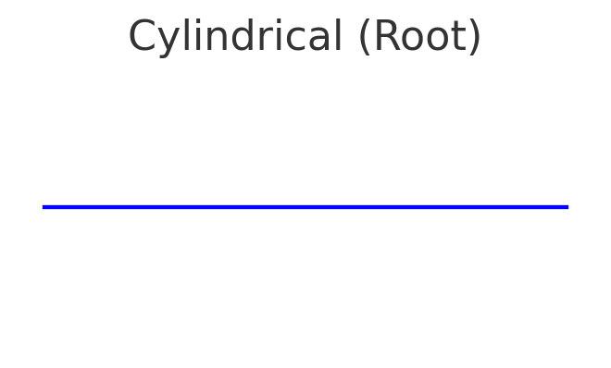
Airfoils Used in NREL 5 MW Blade
> Blade Section Division
•Root region (0–17% span)
• Mid-span region (~17–80% span)
• Tip region (~80–100% span)
> Root Region (0–17% span)
• Cylindrical profile (non-lifting)
• Structural strength and manufacturability
• Smooth transition hub → aerodynamic section

Slide 4
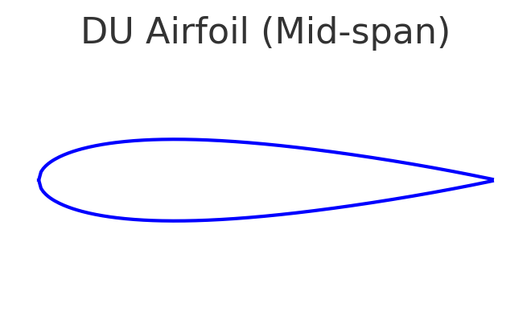
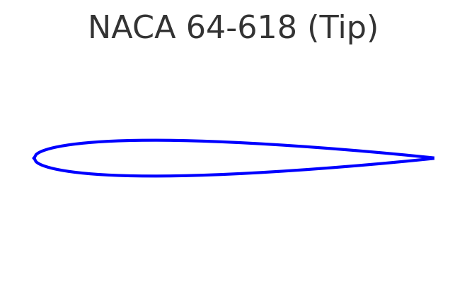
Airfoils Used in NREL 5 MW Blade
> Mid-span Region (~17–80% span)
• DU airfoils (DU21-A17, DU30-A17, DU35-A17, DU40-A17)
• Thick (17–40% thickness-to-chord)
• Structural stiffness and aerodynamic efficiency
> Tip Region (~80–100% span)
• NACA 64-series (NACA 64-618)
• Thin, low-drag
• Reduces aerodynamic losses, noise, stall sensitivity
• Optimized for high Reynolds numbers

Slide 5
Aerodynamic Guidelines (Syria)
Maintain precise aerodynamic surface contours (chord length, thickness, and twist angle) to ensure stable performance across variable wind speeds.
Use enhanced leading edge erosion protection (hard coatings, erosion tapes) to resist sand and dust abrasion from desert winds.
Check and verify blade profiles for operation across the expected Reynolds number range for local wind speeds.
Perform regular aerodynamic load comparisons and checks to ensure compliance with design specs under gusty desert winds.
Consider low maintenance surface finishes to reduce the frequency of on site repairs in remote locations.
Include noise reduction design measures where turbines will be near villages or agricultural areas.

Slide 6
Key Guidelines for Syrian Conditions
High-temperature resistance: select materials, adhesives and coatings rated for sustained high summer temperatures (commonly >35°C in many regions).
Erosion resistance: robust leading edge protection and replaceable erosion strips to cope with sandstorms and abrasive dust.
Dust and sand management: design features and maintenance plans that reduce dust ingress and abrasion (e.g., protective seals, scheduled inspections after storms).
Structural reinforcement: consider local gust factors and higher stiffness or tailored spar sizing to control tip deflection and avoid tower strikes.
Low-maintenance design: favour durable coatings and modular replaceable parts since remote desert sites can be hard to access frequently.
Lightning protection: include appropriate lightning protection even if storms are infrequent mountain/coastal sites may still experience thunderstorms.
Thermal cycling durability: verify long term performance of composites and adhesives under repeated heating and cooling cycles.
Site verification: finalize designs after analyzing site specific wind data (mean wind speeds, extreme gusts, turbulence intensity) and local environmental reports.

Slide 7
Week 2 – Work Done
.
Tasks Completed:
Learned about the functions of the Q Blade.
Used data from the previous week’s PPT to perform hand calculations.
Found that the blade length from the calculation was 35 m.
Challenges:
Unsure how a 35 m blade can generate 5 MW.
The calculation result seems incorrect.
Need updated load data to continue the design.
Next Steps:
Request corrected load data from the load team, as instructed by the professor.
Include corrected calculations in the report.
Collect data from project manager to design a 5 MW turbine.

Slide 8
Bibliography
Jonkman, J., Butterfield, S., Musial, W., & Scott, G. (2009). Definition of a 5-MW Reference Wind Turbine for Offshore System Development. National Renewable Energy Laboratory (NREL/TP-500-38060).
Fuglsang, P., Bak, C., & Madsen, H.A. (1998). Design and Verification of the Risø-B1 Airfoil Family for Wind Turbines. Risø National Laboratory.
Somers, D.M. (1997). Design and Experimental Results for the S819, S820, and S821 Airfoils. NREL/SR-440-6918.
Abbott, I.H., & von Doenhoff, A.E. (1959). Theory of Wing Sections: Including a Summary of Airfoil Data. Dover Publications.
National Renewable Energy Laboratory (NREL). (2009). NREL 5 MW Reference Turbine Documentation.

